Slide 1

SPFx Extensions

Slide 2
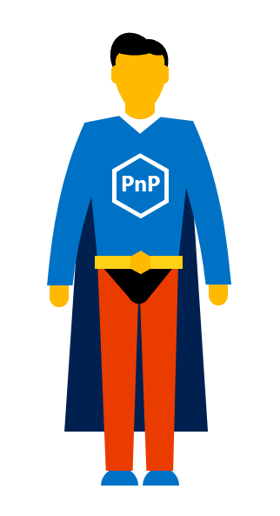

Agenda
What is SPFx Extensions
Types of SPFx Extensions
Application Customizer
Field Customizer
Command Set
Notes:
Grundet vores MS mand er blevet fordringer, afsætter vi ekstra tid til på Hands-on labs

Slide 3
What is SPFx Extensions
Extends the SharePoint user experience
(In SPFx anything that’s not a Web Part)

Slide 4
Types of SPFx Extensions
Application Customizer
Field Customizer
Command Set
Notes:
Grundet vores MS mand er blevet fordringer, afsætter vi ekstra tid til på Hands-on labs

Slide 5
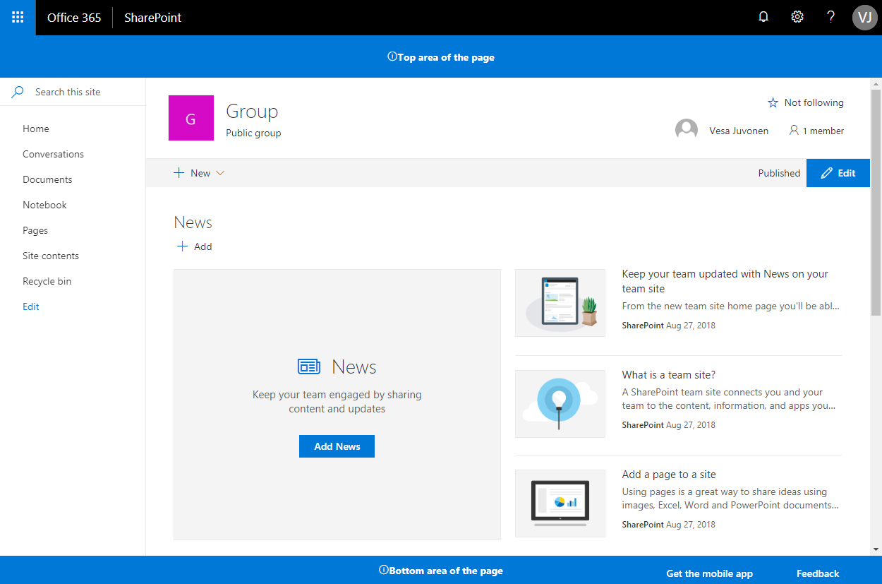
Application Customizer
Add scripts to the page (ScriptLink Custom Action)
Can access well-known HTML element placeholders
(Delegate Control)

Slide 6
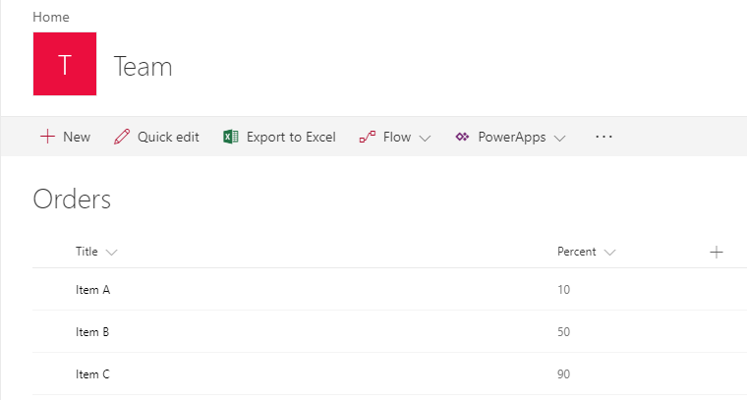
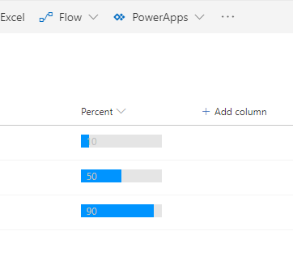
Field Customizer
Change rendering of a Field (JSLink)

Slide 7
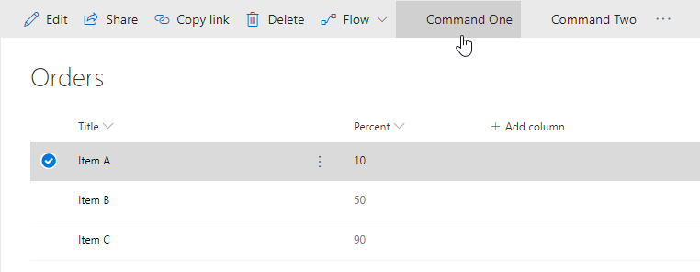
Command Set
Add commands to List View (ECB Menu items)

